Slide 1
Project of sprint 1 Presentation
Name : Bhagyashri Arun Mundhe
Emp id : 46234770
Bach : . Net core azure batch 3
Guided by : Vikas Verma

Slide 2
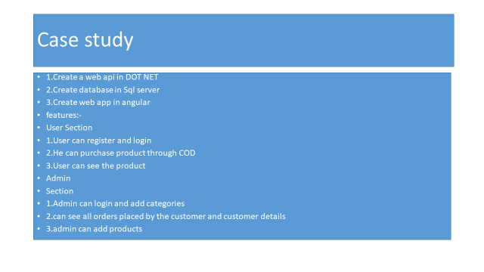

Slide 3
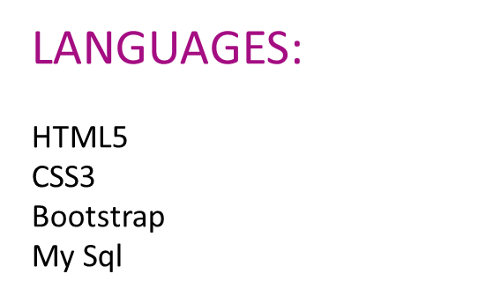

Slide 4
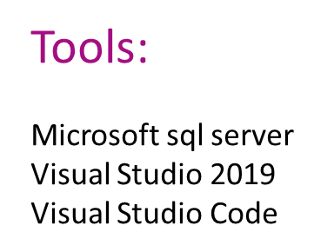

Slide 5
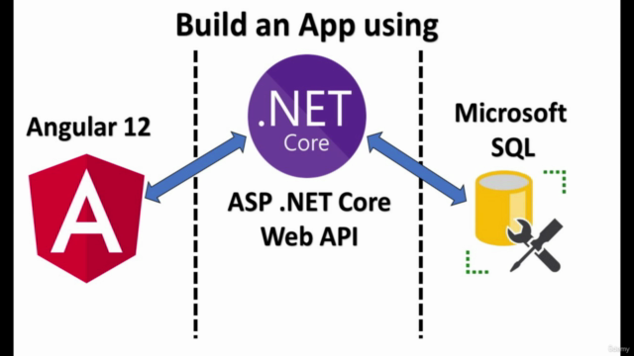

Slide 6
Methods:
Creation of ASP. Net core web API
Implementation of Controllers & Models for Backend
SQL query commands for storing the data into database
Implementation of Angular for the e-commerce application
Implementation of Login & Register part
Implementation of Authentication part for user and admin
Implementation of add products & edit products for the admin
Implementation of add to cart for the user

Slide 7
Database
sql
Web Api
Ecommerce
Web
api
Angular part of
Frist –sample –project
In Ecommerce_Api

Slide 8
Its My github Repositorie :
https://github.com/bhagyashri010120/project-login.git

Slide 9
conclusion
I think this article will be very helpful for the beginners who are want to learn Angular 10, WebApi, SQL-SERVER Data First. I am not good at English, If I mistake anything please forgive me. Thanks for give me the your important time .

Slide 10
THANK YOU !

